Slide 1
Making maps in Shiny
Class 10

Slide 2
Agenda
Reactive Q&A
Reactive Spatial Data
renderLeaflet()
Leaflet Proxy
Remove/Clear

Slide 3
Reactivity
in space

Slide 4
Not much has changed
Spatial DataFrame can be subset
Not easily piped
For some: ☹ Others: ☺

Slide 5
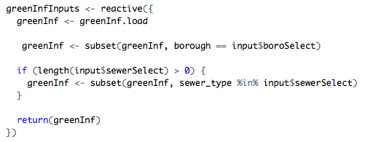
Reactive Spatial Data Example

Slide 6
The Easy WAy
But ultimately harder on your server and requires more loading time

Slide 7
Build your leaflet map and pipe in the reactive data

Slide 8
Shiny Proxy

Slide 10
Empty Map

Slide 11
Observer your reactive data

Slide 12
Clear versus Remove

Slide 13
Hide

